Slide 1
Theory of Computation
CSE 3101
Lecture # 10
Md. Manowarul Islam
Lecturer, Dept of CSE
Jagannath University

Slide 2
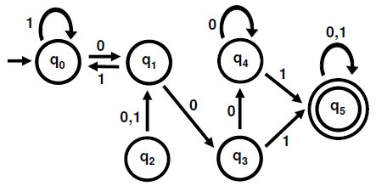
Example

Slide 3

Example

Slide 4
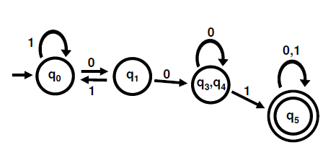
Example

Slide 5
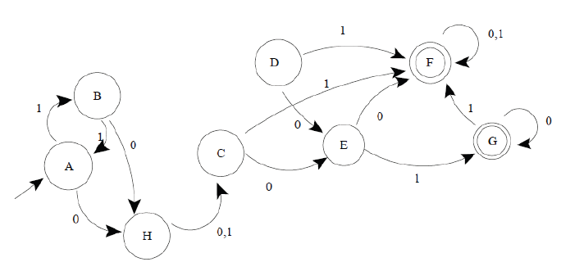
Example

Slide 6
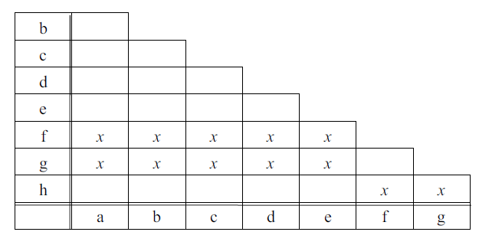
Example (Step-1)

Slide 7
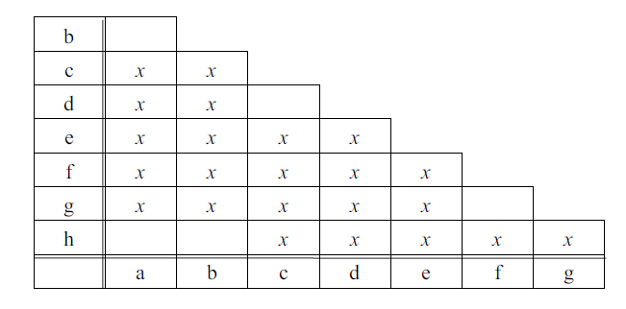
Example (Step-1)

Slide 8
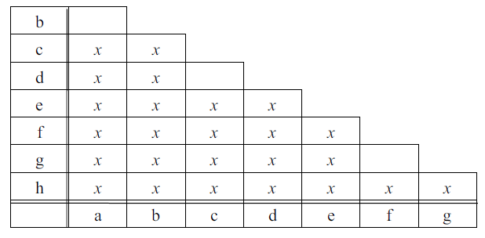
Example (Step-2)

Slide 9
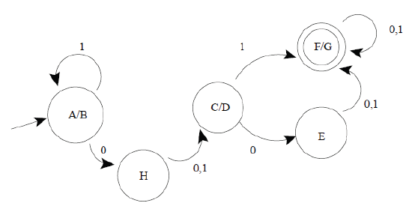
Example

Slide 10
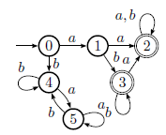
Example

Slide 11
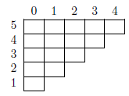
Example

Slide 12

Example

Slide 13

Example

Slide 14

Example

Slide 15

Example

Slide 16
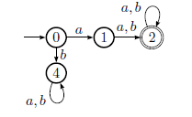
Example

Slide 17
END

